Slide 1
Growing Engagement
Levi Siebens
Director of R&D at XMedius

Slide 2
Engagement
Three Levels Of Engagement
Engaged
Not engaged
Actively Disengaged

Slide 3
Engaged Worker

Slide 4
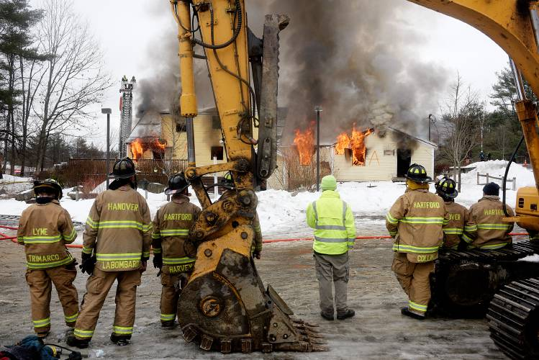
Not Engaged Worker

Slide 5
Actively Disengaged

Slide 6
State Of Engagement
Notes:
https://www.gallup.com/services/178517/state-global-workplace.aspx

Slide 7
State Of Engagement - Impact
Most people don’t want to work where others don’t care
No one wants to work with arsonists
“ the average U.S. employee is not only unengaged at work, but half of U.S. employees are actively searching for a new job.” - Forbes
This creates a loss in productivity of 450 - 600 billion a year across the economy - Forbes
Whether it’s financial, environmental, or just personal, people want to work in a place they care about.
Notes:
https://www.gallup.com/services/178517/state-global-workplace.aspx

Slide 8
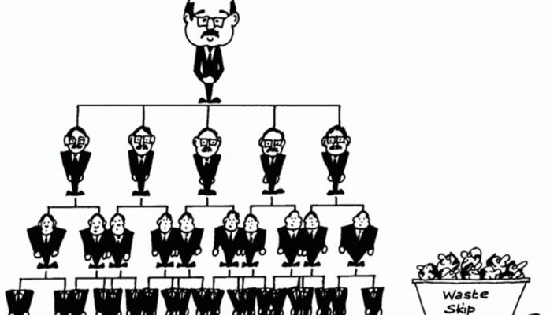
How Did We Get Here?
Traditional management philosophies define a hierarchical structure to how they function
Notes:
https://www.gallup.com/services/178517/state-global-workplace.aspx

Slide 9
How Did We Get Here?
Top down management is easy to define, easy to follow and is effective in specific situations
Factories, assembly lines and such can perform well in these top down structures (Quota Based)
Doesn’t create engagement as the employee is not engaged
Notes:
https://www.gallup.com/services/178517/state-global-workplace.aspx

Slide 10
Management 1.0
“[the] common practice is that [organizations] are managed like machines, with their workers treated as gears and levers….[T]he organization consists of parts and that improvement of the whole requires monitoring, repairing, and replacing those parts.” (Managing For Happiness)
Have you heard this:
“Just write more code!”
“Just file more bugs!”
“Your performance is subpar because Susan performed X% better on metric Y that we measured this year!”
Employees are told what to do, and often how to do it.
Notes:
https://www.gallup.com/services/178517/state-global-workplace.aspx

Slide 11
Management 2.0
Improves on Management 1.0 by recognizing people are not cogs in a machine.
“[Management 2.0] correctly understands that improvement of the whole organization is not achieved by merely improving the parts…[however], they prefer to stick to the hierarchy and have a tendency to forget that human beings don’t respond well to top-down control and mandated ‘improvements’” (Managing For Happiness)
People are considered when decisions are made, but do not get to make the decisions themselves.
Notes:
https://www.gallup.com/services/178517/state-global-workplace.aspx

Slide 12
Management 3.0 and Systems
Management 3.0 is a holistic philosophy on what it means to manage people that does not start from the traditional management models
Created by Jurgen Appelo, it focuses on both individuals, their interactions and the environment that they are a part of, called a system.
Notes:
https://www.gallup.com/services/178517/state-global-workplace.aspx

Slide 13
What Is A System?
Are the people part of the system? Yes.
Are the processes within the organization part of the system? Yes.
Is the physical space (or distributed space) the people exist in part of the system? Yes.
Is what the group / team / organization accomplishes part of the system? Yes.
Is everything a part of the system? Yes.
Notes:
https://www.gallup.com/services/178517/state-global-workplace.aspx

Slide 14
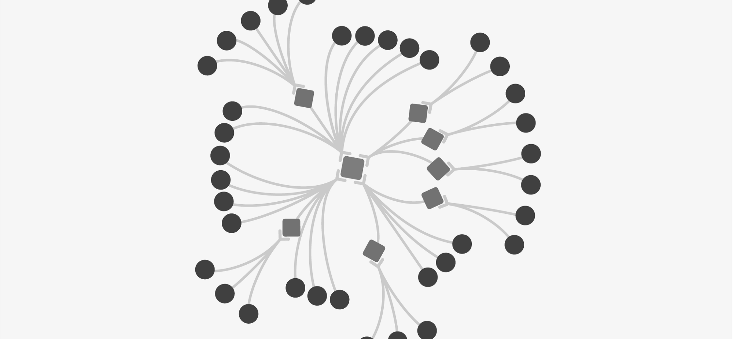
Traditional View Of An Organization
Notes:
https://www.gallup.com/services/178517/state-global-workplace.aspx

Slide 15
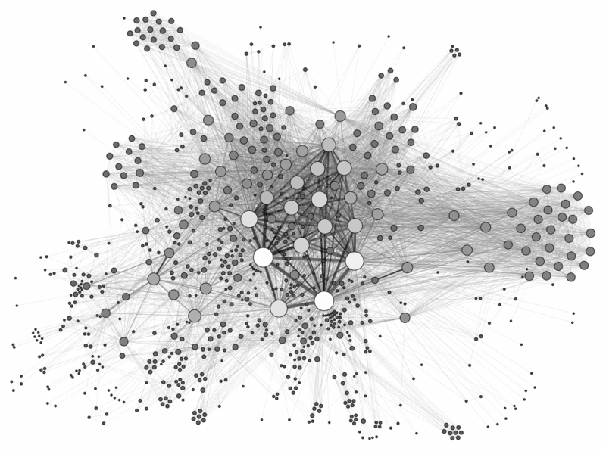
System View Of An Organization
Notes:
https://www.gallup.com/services/178517/state-global-workplace.aspx

Slide 16
Systems
What is a system: A complex set of interactions, behaviors and environmental factors.
Why is this important to understand?
Our workplaces are complex systems, whether we acknowledge it or not.
Top down decisions can be decisions made at the wrong level. Those closest to the thing understand it the best.
Creating change is a complex thing. Often there will be nonlinear results.
Creating engagement is hard when you are distant from where the change is occuring.
Notes:
https://www.gallup.com/services/178517/state-global-workplace.aspx

Slide 17
Management 3.0
Management 3.0 leverages an understanding of complex systems to create six aspects of management to focus on that will increase engagement and improve any organization.
Notes:
https://www.gallup.com/services/178517/state-global-workplace.aspx

Slide 18
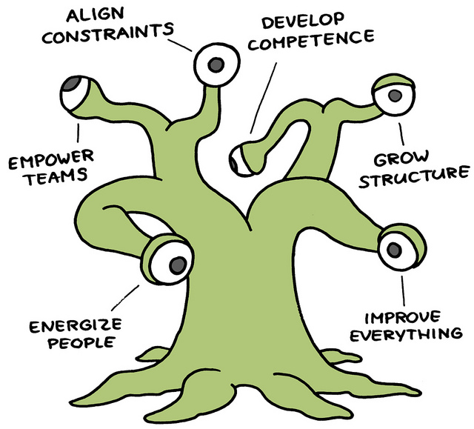
Marty The Management Monster
Notes:
https://www.gallup.com/services/178517/state-global-workplace.aspx

Slide 19
Energize People
How do you impact the system to increase motivation across it?
Understand Needs And Desires
Acceptance, Curiosity, Power, Honor, Idealism, Independence, Order, Social Contact, Status, Competence
Create an open environment for communication
Leaders can be wrong!
Dynamic Facilitation
Let those closest to the work make decisions
Notes:
https://www.gallup.com/services/178517/state-global-workplace.aspx

Slide 20
Empower Teams
How can teams better be empowered to make their own decisions?
Delegation, Delegation, Delegation
Notes:
https://www.gallup.com/services/178517/state-global-workplace.aspx

Slide 21
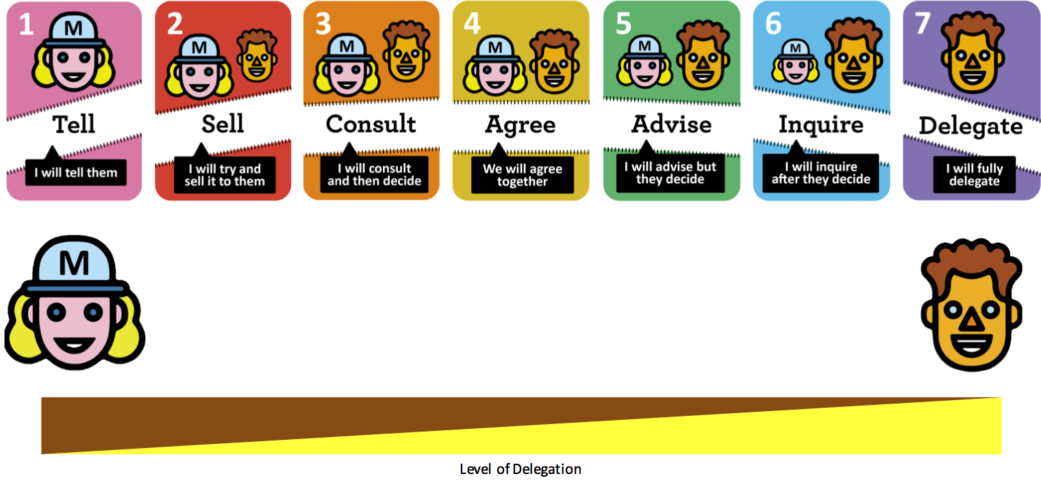
Delegation Poker
Notes:
https://www.gallup.com/services/178517/state-global-workplace.aspx

Slide 22
Empower Teams
How can teams better be empowered to make their own decisions?
Delegation, Delegation, Delegation
Be clear on what is being delegated
Be clear on the accountability of the delegation
Push to delegate more!
Build confidence in the teams that they can make their own decisions
Provide the teams with the freedom to fail
Notes:
https://www.gallup.com/services/178517/state-global-workplace.aspx

Slide 23
Align Constraints
What is our purpose? Why do we exist?
Create a shared sense of vision. This means sharing in the creation process
“We want everyone who is involved in a business to find it valuable.” - Jurgen Appelo
Make the vision visual, a narrative, a story that can be told (The Hammer!)
Communicate to everyone, and measure if everyone understands
Notes:
https://www.gallup.com/services/178517/state-global-workplace.aspx

Slide 24
Develop Competence
How do people grow? How do they gain mastery?
Growth is one of the most desired traits from a workplace
Types Of Learning
Self Development
Coaching / Mentoring
Training / Certification
Culture of Knowledge Sharing
Tools / Infrastructure
Supervision of Growth
Use concepts like 守破離 (Shuhari)
Notes:
https://www.gallup.com/services/178517/state-global-workplace.aspx

Slide 25
Grow Structure
How does the organization / community / system grow?
Change the Environment: Open office not working, get taller walls! Cubicle walls getting in the way, get rid of them!
Community of practice: Common passions pulling together disparate backgrounds for a common goal
Huddle: Informal get togethers that don’t require managers
Sharing Meals: It’s amazing what happens when people talk to one another
[Insert Hobby Here...Board Games!]: Shared time can help more to build and grow the system
Notes:
https://www.gallup.com/services/178517/state-global-workplace.aspx

Slide 26
Improve Everything
How can the system always improve?
Looking Forward, think what could be
Look Backwards, think of what has happened
Experiment in small, understandable ways. Measure if you like! But always get quick feedback.
Failure will happen, that’s where learning can occur about a complex system (nonlinear)
Notes:
https://www.gallup.com/services/178517/state-global-workplace.aspx

Slide 27
Summary
Organizations are complex systems that require us to think deeply about how to create engagement
Engagement can happen and can be improved, but it takes thinking about our teams as groups of people and systems, not just individuals that need to change behaviors.
“Adapt what is useful, reject what is useless, and add what is specifically your own.” - Bruce Lee
Notes:
https://www.gallup.com/services/178517/state-global-workplace.aspx

Slide 28
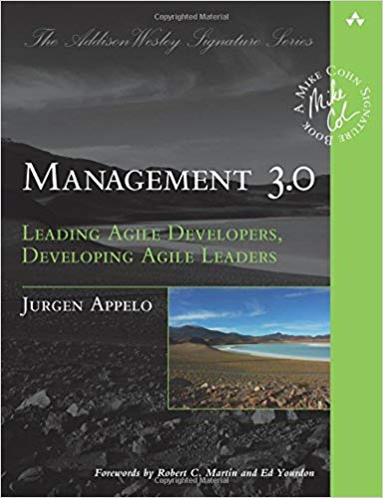
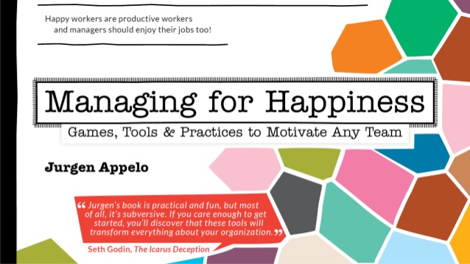
Books
Notes:
https://www.gallup.com/services/178517/state-global-workplace.aspx

Slide 29
Questions
Notes:
https://www.gallup.com/services/178517/state-global-workplace.aspx

